Slide 1
Accessing Autism Testing in Diverse Communities
MICHELLE CREEKMORE &
CHRIS FOSTER
Notes:
MICHELLE
Introductions

Slide 2
Funding and Support
Notes:
MICHELLE

Slide 3
Autism Prevalence
The prevalence of autism rose to 1 in every 36 eight-year-olds in 2020 – almost 4 times greater than the 2004 rate of 1 in 125.
Children who receive an autism diagnosis by age 4 are 50x more likely to receive services.
The CDC estimates that 2.21% of adults in the US have autism. That’s 5.44 million adults, 80% of whom are men.
Info from: https://autismsociety.org/the-autism-experience/ and https://www.cdc.gov/ncbddd/autism/features/adults-living-with-autism-spectrum-disorder.html
Notes:
MICHELLE

Slide 4
Autism Prevalence
Data | Alabama | National
Percent of 8-year-olds with autism (Worldwide prevalence is 1 in 100 children) | 3% (1 in 33) | 2.9% (1 in 36)
Average age of diagnosis Higher-income families (at or above 200% of federal poverty level) Lower-income families (below 200% of federal poverty level) | 5.01 years old 4.96 years old 5.04 years old | 5.0 years old 5.2 years old 4.7 years old
Average age of first intervention | 4.86 years old | 4.7 years old
Children with autism that received Special Education and/or EI | 77% | 86%
Data from https://nationalautismdatacenter.org/autism-by-the-numbers/
Notes:
MICHELLE
Interesting to note that in AL, lower income families receive a diagnosis later – opposite of national trends
Alabama is also a bit later with children accessing first interventions. AL is working hard on this trend with Early Intervention services. At our autism diagnostic clinic, we ensure that any children referred that are less than 3 years old are accessing Early Intervention services even while on the waitlist. As well, earlier diagnosing which will lead to better access to services at an earlier age.

Slide 5
Autism & Diversity – Changes over time
Autism and Developmental Disabilities Monitoring (ADDM) Network reports have consistently noted that more White children are identified with ASD than Black or Hispanic children. Previous studies have shown that stigma, lack of access to healthcare services due to non-citizenship or low-income, and non-English primary language are potential barriers to identification of children with ASD especially among Hispanic children. A difference in identifying Black and Hispanic children with ASD relative to White children means these children may not be getting the services they need to reach their full potential.
https://www.cdc.gov/ncbddd/autism/addm-community-report/differences-in-children.html
In 2017, the prevalence rate of ASD diagnosis in Black children was 2.05% compared with 2.30% for White children. However, in 2021, the prevalence rate in Black children was 4.01% compared with 3.89% in White children.
https://www.ncbi.nlm.nih.gov/pmc/articles/PMC9623438/
Notes:
MICHELLE

Slide 6
Autism & Diversity – Changes over time
2020
Autism prevalence is lower among White children than other racial and ethnic groups:
White – 2.4%
Black – 2.9%
Hispanic – 3.2%
Asian or Pacific Islander – 3.3%
These changes reflect an improvement in outreach, screening, and de-stigmatization of autism diagnosis among minority communities.
*The CDC autism prevalence estimates are for 8-year-old children across 11 monitoring sites in the Autism and Developmental Disabilities Monitoring (ADDM) Network in 2020.
Source: Centers for Disease Control and Prevention (2023)
Notes:
MICHELLE
Diagnostics are improving across most racial groups

Slide 7
Early Is Best
“Diagnosing children with ASD as early as possible is important to make sure children receive the services and supports they need to reach their full potential.” https://www.cdc.gov/ncbddd/autism/screening.html
“… autism spectrum disorder diagnosis before the age of 2.5 is associated with considerable improvement in social symptoms.” https://journals.sagepub.com/doi/full/10.1177/13623613211049011
“A growing body of evidence supports the value of early diagnosis and treatment with evidence-based interventions, which can significantly improve the quality of life of individuals with ASD as well as of their careers and families.” https://www.ncbi.nlm.nih.gov/pmc/articles/PMC5576710/
Notes:
MICHELLE

Slide 8
Diagnostic Clinic
Notes:
MICHELLE
So we have established the importance of reaching different racial and socio-economical groups and doing so at an early age. Which leads us to our autism clinic model.

Slide 9
How It All Began…
The Arc of Madison County saw a need in our community for autism testing and services for children ages 24 months through 5 years of age. More specifically, testing and services that could be accessed by families that have been unable to receive these due to travel and insurance restrictions.
Notes:
MICHELLE
At The Arc of Madison County, we often say that we find a need and fil it. We saw the need for autism testing in our community. The wait time for autism testing is 1-2 years at most evaluation sites. Furthermore, the options for autism testing for families with Medicaid are limited, especially in Alabama. Low-income families often have limited transportation, which makes getting to diagnostic clinics 1.5-2 hours away, difficult.
** Prynceton’s story **
Based on the research we just discussed, it was determined to focus our Autism Clinic towards our younger population and we are serving children 2 through 5 years of age at this time.
Our autism diagnostic clinic officially began in September of 2022. Prior to that was almost a year of prep work, including understanding the areas of need, gathering materials and personnel, discovering the billing process, reaching out to local pediatricians, and determining the costs. Which is what we are here to share!

Slide 10
Daniel’s Story
Notes:
MICHELLE
It’s not just low-income families!
Out-of-state testing
Extensive paperwork
Expensive – cost of testing, car expenses, food for whole day trip
All day clinic – exhausting
Incorrect birth history in report
Was told child would be nonverbal for his entire life
Report had another child’s name in it
Limited testing done – unable to support school services without further testing
We can do better than this!

Slide 11
Diagnostic Process
Referral
Gather info, records, & medical/ developmental history
ST, OT, & developmental evaluations
Autism Diagnostic Interview-Revised (ADI-R)
Autism Diagnostic Observation Schedule, 2nd Ed. (ADOS-2)
Autism Spectrum Rating Scale (ASRS)
Comprehensive Evaluation Report
Notes:
CHRIS
When a referral is made, we gather a signed referral from the physician for the autism evaluation and any other evaluations that need to be completed. We then contact the family to determine interest in moving forward with the autism diagnostic process.
If the family is interested, we gather signed releases from the family to obtain any records or reports. We gather any records necessary from the physician as well as outpatient records. We also complete a developmental and medical history interview with the family.
If ST & OT evaluations have not already been completed, we schedule these through our Pediatric Outpatient Center at The Arc of Madison County. We will also complete a developmental evaluation if needed, although many children come to us with EI services already in place.
The ADI-R is completed with the family, typically by phone. We have 6 people on staff that can complete the ADI-R.
The ADOS-2 testing is done in-house. We currently have 6 people on staff that are trained on the ADOS-2.
The ASRS is a behavior rating scale that is completed by the caregivers during the ADOS-2 testing visit.
***** We have additional testing that we can use on an as-needed basis to assess a child’s sensory needs (MIGDAS)
Our Comprehensive Evaluation Report is then completed by our Autism Diagnostic Clinicians and LPC with additions from the other members of the team. Our evaluation report includes all testing results that we have completed, a summary of any outside testing that has been completed, interview and behavior rating scale information, as well as a thorough list of suggestions and recommendations for support. Some of our recs include school system services, genetic testing, speech & OT services, and sometimes ABA therapy. We also make sure to include actual strategies that families could begin to implement right away instead of waiting on additional waitlists for other services. We also created resource packets to give to each family upon their final results, no matter the diagnosis.
Comprehensive evaluation means at least 2 sets of eyes on every child

Slide 12
Autism Clinic Team
Susan Klingel, Executive Director
Michelle Creekmore, Early Childhood Program Director
Wendy Pittard, Autism Services Director
Team Member | Degree | Responsibilities
Pediatrician | M.D. | Diagnosing, results sessions
Autism Diagnostic Clinicians | M.A. Psychology | ADOS, MIGDAS, ADI-R, report summarizing
Autism Clinic Coordinator | B.S. Communication Disorders | ADI-R, developmental evaluation, family interview, scheduling, wait list management, expansion
Speech-Language Pathologists | CCC-SLP | ADOS, speech therapy evaluations
Occupational Therapists | OTR | Occupational therapy evaluations
Family Support Specialists | B.A. Social Work | ADI-R, developmental evaluation, family interview, services support
Notes:
CHRIS
2 Autism Diagnostic Clinicians
2 SLPs

Slide 13
Partnering with Pediatricians
Initial support
Lunch & Learns
30 pediatricians giving diagnosis with our clinic
14 entire pediatric practices
Pediatricians are diagnosing for their CRNPs as well
Notes:
CHRIS
Discuss Dr. Nord & Dr. Brassart with initial support and willingness to try one
Discuss Dr. Schwartz & Dr. Anderson support
Goal – results on time, no additional costs, continuity of care for the clients, pediatricians can bill for the results session
Lunch & Learns
How to request a L&L, how to choose which practices to target – those making referrals
Model
Closing the deal (emails of pediatricians and referral nurse, try one?)
Funding
Aiming for pediatricians who accept Medicaid (and health dept physicians) as our goal is to be a resource for low-income families. Families with private insurance often have many other options for diagnostic testing.
**Partnership** - often talk together to review the testing results when deciding on the final Dx and levels of support needed

Slide 14
Diagnosing & Results
Pediatrician
Staff Pediatrician
Comprehensive evaluation report & DSM-5 checklist completed for review
The pediatrician gives final clinical diagnosis and gives the results to the family
Allows for quicker turn-around on results
Provides families with a consistent touchpoint
Continuity of care
Comprehensive evaluation report completed for review
Gives the final clinical diagnosis & reviews the results with the family face-to-face
Viable option when CRNP as primary medical provider
Also available when child’s pediatrician/ physician is unwilling to give the final medical diagnosis
Notes:
CHRIS
The Arc of Madison County is partnering with several pediatricians in north Alabama to allow the pediatrician to determine the child’s diagnosis, if applicable.
When the pediatrician is willing to give the final Dx...
We provide the pediatrician with the comprehensive evaluation report, along with a partially completed DSM-5 checklist.
The pediatrician reviews the report and DSM-5 checklist, completes the DSM-5 Autism Diagnostic Tool for Healthcare Providers, and signs off on the final clinical diagnosis (if applicable). The pediatrician then gives the results to the family .
Having the pediatrician give the final diagnosis allows for a quicker turn around, as the family is not having to wait on a results session within our autism clinic.
This also allows the family a consistent point of contact, as their pediatrician will continue to provide support to the family and assist them with accessing additional services as their child develops.
When a pediatrician is not available…
Our staff pediatrician is able to determine the final clinical Dx (if applicable)
We then have a face-to-face meeting with the family to discuss the results
Currently, we are using this practice when the child has a CRNP as their primary medical provider, as a CRNP alone cannot sign off on an autism Dx
This practice is also available if the family's pediatrician is not willing to provide the Dx themselves

Slide 15
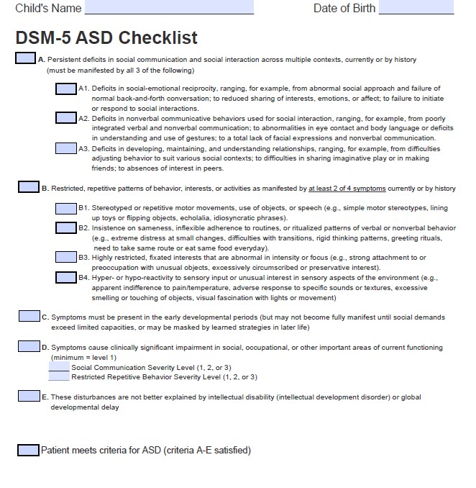
Notes:
CHRIS

Slide 16
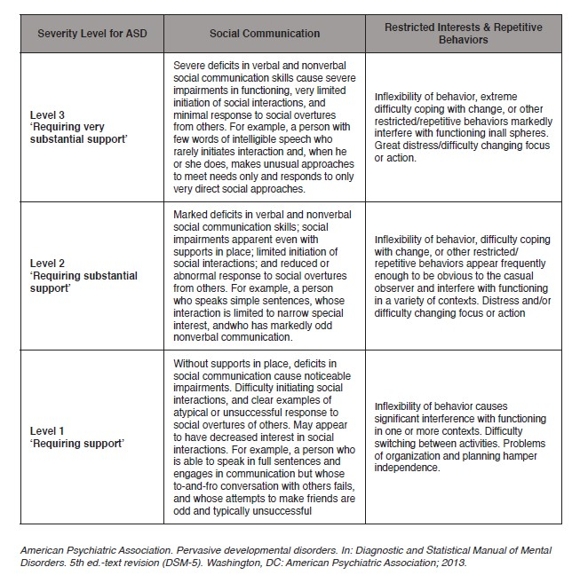
Notes:
CHRIS

Slide 17
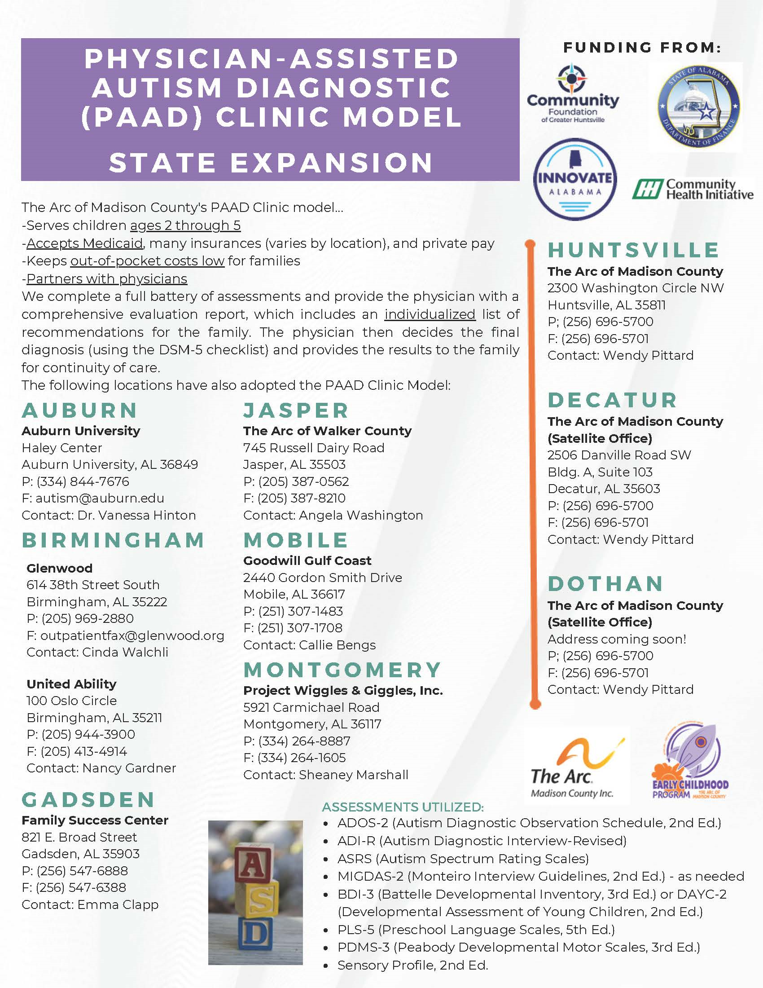
Reaching Across the State
Notes:
MICHELLE
As we saw the need in north Alabama and began this clinic, others took notice and wanted to support their communities as well! We have now assisted several other Alabama communities with developing similar autism diagnostic clinic models.

Slide 18
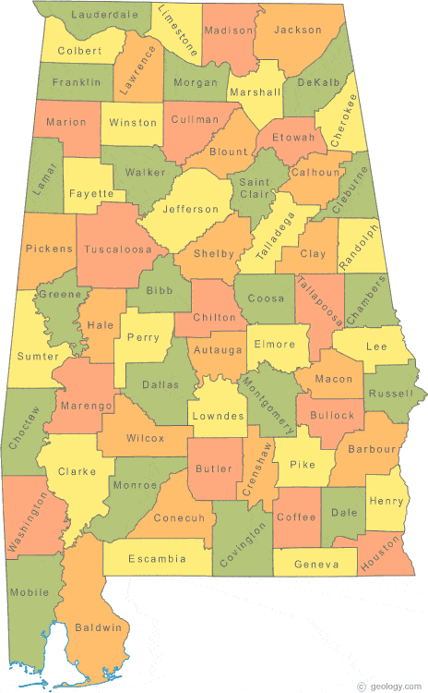
Autism Clinic Statewide Data
Referral Information | Total
All Referrals | 2,427
-Males | 1,714
-Females | 713
Diagnostic Process Completed | 809
-Diagnosis of Autism Given | 498
-Autism Diagnosis with Medicaid | 382
55 out of 67 counties in Alabama are considered rural
(Alabama Rural Health Association)
Statewide, we are currently serving 53 counties in Alabama (41 of which are rural), as well as families from MS, TN, & FL
Notes:
MICHELLE
Since our clinic’s inception in Sept. 2022, our clinic ALONE has received 1,485 referrals.
About 77% of all our referrals have Medicaid, while 23% have private insurance, ALL Kids, or self-pay
Along with our partnering programs, we have received referrals from 53 of Alabama’s 67 counties and even Mississippi, Tennessee, & Florida
About 24% of our referrals are from Madison County.
Outreach process

Slide 19
Autism Clinic Data
Notes:
MICHELLE
Of the 809 children that we have completed the diagnostic process with, we have had 7 race categories represented:
472-White, 220-Black, 67-Hispanic, 37-Bi-Racial, 8-Asian, 4-American Indian, 1-Hawaiian
Referrals by Month – steadily increasing over time
Our average wait time is 4-5 months between referral and beginning the diagnostic process. Most of our partner programs have an even shorter wait list time. As we stated previously, most other diagnostic clinics wait times around the state are 1-2 years.
We have a Spanish interpreter that can assist us with our Spanish speaking families when needed.

Slide 20
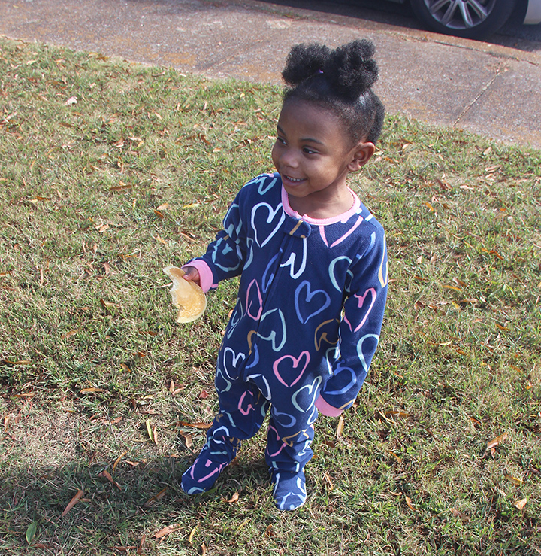
Malia’s Story
2 years old
Low-income family with limited resources
Early Intervention services since February 2023
Autism diagnosis June 2023
Our services have helped Malia’s family with her development
Our Diagnostic Clinic Impacts Lives
Notes:
MICHELLE
It’s these families that weren’t getting services in the past. That’s why we do it. That’s what drives The Arc. We are getting her a great start early. We are getting her support as early as we possibly can.
This clinic is supporting children and helping them access other services, such as Early Intervention and the local school systems.

Slide 21
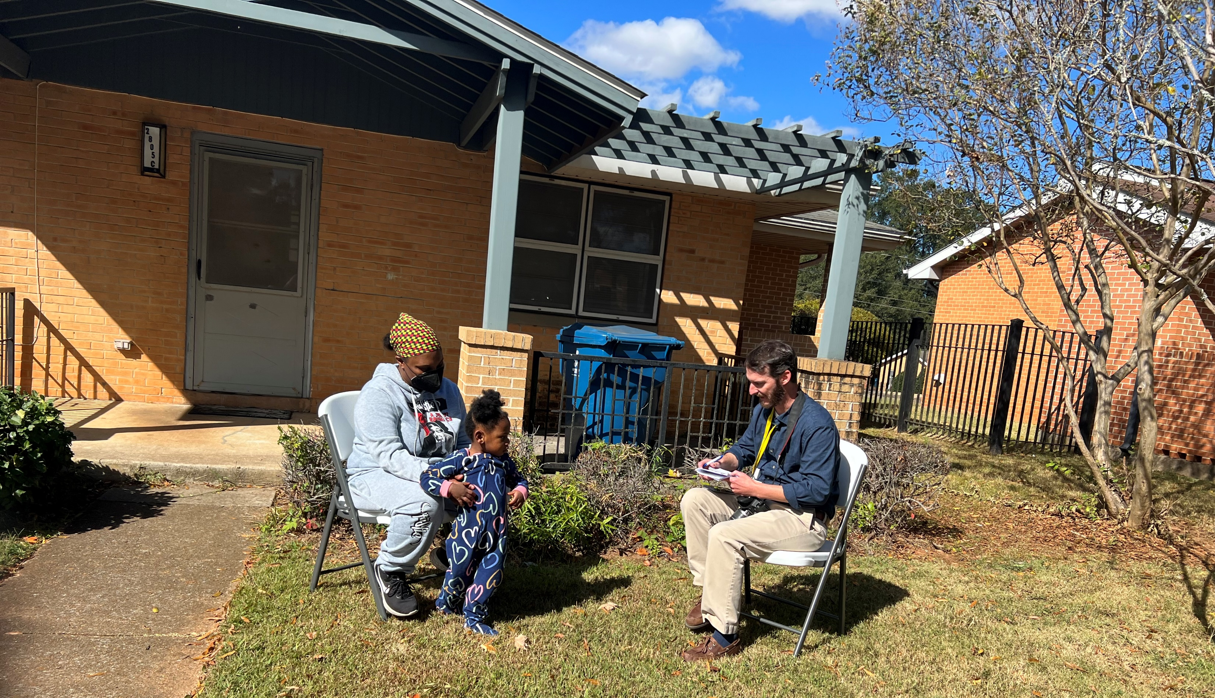
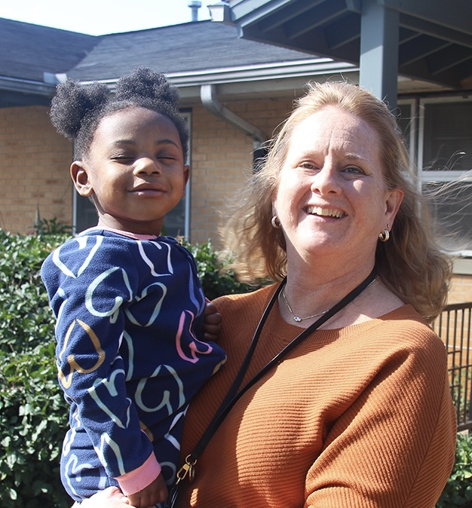
Malia’s Story
Notes:
MICHELLE
Single mom, unable to read
Living in an apartment owned by the housing authority
Her apartment has limited furniture inside (even the chairs you see in the picture were brought by The Arc)
Has an 8-year-old son in school who is also receiving special education services through the school system
Ashley upset, worried, and cold in her apartment and heat not turning on (mid EI Conference). We contacted the social worker with the housing authority and explained the issue as Malia’s mom, Ashley, was not comfortable contacting them herself. We were able to get the housing authority to go down to their apt and fix the issue that same day.
This family, and many others, would have fallen through the cracks without our help.
This kind of family situation is why we started our autism clinic and knew we had to help low-income families.

Slide 22
Cost to Families
Medicaid
BCBS/ALL Kids
TRICARE
Self-pay
Notes:
MICHELLE
Once the need for our clinic was determined, funding had to be secured to make this clinic a reality. We started with a $15,000 grant from our local hospital system.
We are Medicaid, Blue Cross Blue Shield, and Tricare approved and are in the process of being approved by United Healthcare.
For our families with insurance, they pay the difference from what their insurance doesn’t cover. The most a family will pay out-of-pocket is $500. This cost is considerably lower than the majority of other autism diagnostic clinics in our area, which can often run $2000 or more.
For our families with Medicaid, they pay nothing out-of-pocket. What Medicaid doesn’t pay, we cover our expenses with grants.

Slide 23
Autism Services
Notes:
MICHELLE
The goal with our autism clinic was never just to provide diagnostics. We want to be able to support our families with services. The goal is to offer autism services for continued support. Just as with diagnosing, the options for Medicaid-eligible families are very limited. We want to be able to offer our low-income families appropriate services that were affordable and readily available.

Slide 24
Behavioral Education Support Training (BEST) Curriculum for Families and Professionals
Dr. Vanessa Hinton, Professor Auburn University
Dr. Yusuf Akemoglu, Visiting Scholar at the University of Buffalo
Notes:
MICHELLE
Home-to-Classroom Curriculum with guidance from a family support specialist

Slide 25
Challenging Behaviors
Tantrums
Biting
Kicking
Yelling
Hitting
Notes:
MICHELLE

Slide 26
Curriculum Characteristics
Adult Learning
Partner with families and professionals to empower and build capacity
Educational
Teach developmentally appropriate ways of changing behavior
Child-focused
Help families and professionals individualize strategies that build on the child’s strengths and preferences
Notes:
MICHELLE

Slide 27
Six Modules paired with Coaching
Overview of Challenging Behavior
ABCs of Behavior
Antecedent Strategies
Teaching Strategies
Consequence Strategies
Support Plan
Notes:
MICHELLE

Slide 28
Summary Statement & Competing Pathways Analysis
5
6
DESIRED BEHAVIORS
Natural contingencies for desired behaviors
4
2
1
3
SETTING EVENT
Makes challenging behavior more likely to happen
ANTECEDENTS
Triggers that occur before challenging behavior
CONSEQUENCE
The function that maintains the challenging behavior
CHALLENGING BEHAVIORS
7
ALTERNATIVE BEHAVIORS
Notes:
MICHELLE

Slide 29
My child’s behavior is tantrum, (hit, kick, spit, throw, break things)
My child obtains and/or escapes chores and an unstructured transition
Triggers for my child’s behavior are change in routine, and correction of transition, asked to do a chore.
The behavior I desire is comply with corrections or start new activity
An alternative behavior that still helps my child gain or escape is go to break area (“dugout”) and deescalate
Prevention supports to avoid triggers are Give an overview of day’s activities, Use visual card on arrival , Give early signals to remind for transitions. This makes the tantrum IRRELEVANT because we are going to prepare Peter for chores and unstructured time.
Teaching supports for the desired and alternative behaviors are Visual chart for appropriate behavior paired with adult attention for using the chart (break, work, wait for help)
Prompting by adult: Remind P that he can use “dugout” before difficult tasks or activities, this makes the tantrum inefficient because complying with corrections, starting a new activity, or using the “dugout” will lead to things that Peter really likes, or is a better way to escape.
Consequence supports for the desired and alternative behaviors are to allow any use of “dugout”, attention and rewards for complying with corrections or starting a new activity. Keep Peter & others safe while he is having a tantrum, hold a visual up for Peter to see the chore or the activity that is on the schedule, so that the tantrum is Ineffective as an escape.
Peter’s Support Plan
Notes:
MICHELLE
This is an example of the support plan that will be completed.
Now let’s look at an example of a child who uses challenging behavior for the function of escape, rather than gaining something.

Slide 30
Thank You!
Michelle Creekmore, Early Childhood Program Director
Chris Foster, Lead Clinician
www.hsvarc.org
(256) 696-5700
Notes:
MICHELLE

