Slide 1


AMIkids Welcomes You!
#weareamikids
Notes:
https://www.facebook.com/AMIkids/videos/10155466346842528/?v=10155466346842528

Slide 2

Alabama
Family Services
Utilizing the FFT Model
February 2024

Slide 3

Meet the Team
*Jamelyn Hughes (Sr. FFT Therapist)- Master of Social Work
*Samantha Williams (FFT Therapist & PQI Auditor)- Master of Social Work
*Latanya Simmons (FFT Therapist)- Master of Social Work
*Kendra Johnson, ALC (FFT Therapist)- Master of Clinical Mental Health
*Carmellia Evans (FFT Therapist)- Master of Clinical Mental Health
*Tankiya Morris (Program Manager/FFT Supervisor)- Master of Forensic *Psychology: Victimology & Master of Clinical Mental Health
*Erica Adams- Business Manager

Slide 4
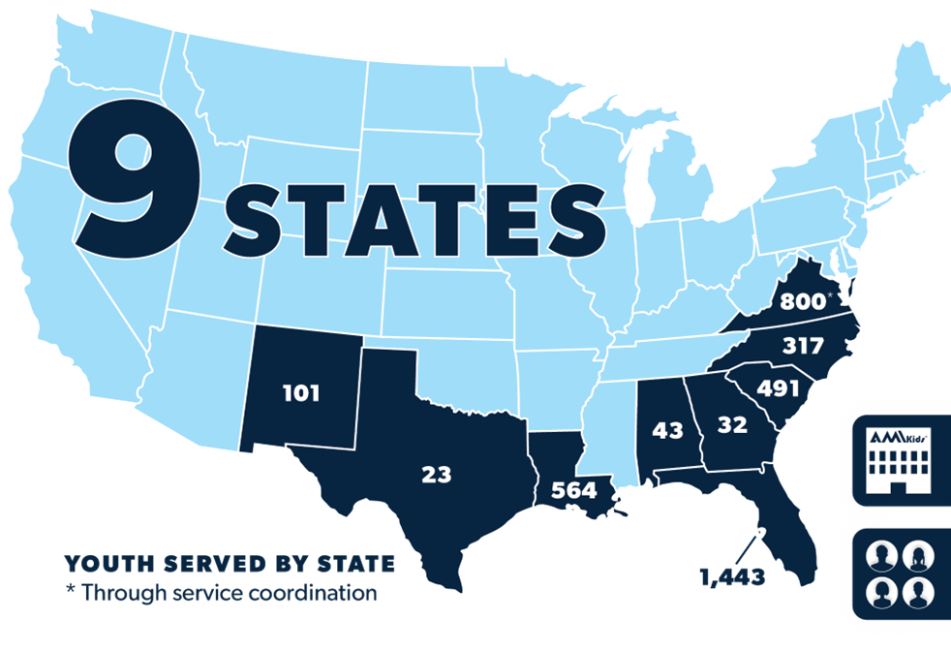
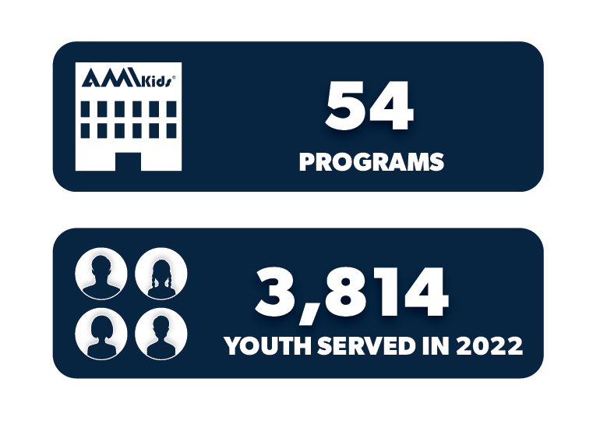
AMIkids Overview
Established over 54 years ago, AMIkids is a national nonprofit operating in 9 states.
Annually, we serve about 4,000 youth across 54 programs.
We serve a variety of youth and families, but have historically served youth at risk of involvement with juvenile justice or child welfare systems.
AMIkids has a long history of providing Functional Family Therapy since 2006
AMIkids currently oversees 7 FFT teams in NC, AL & NM

Slide 5
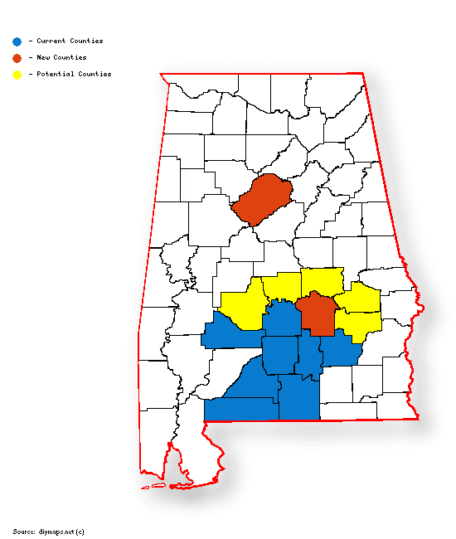
Now serving Jefferson and Montgomery Counties!

Slide 6

What is
It is a short term, home-based family counseling model developed by FFT, LLC. This intensive model assesses and addresses family dynamics that may be impacting the youth’s behaviors, decision making and emotional health. The FFT Model has received international recognition for its outcomes with youth and families to overcome delinquency, substance abuse, and violence.
Each family has a clinician assigned to them that provides a space for respect-based interventions that are culturally responsive and match to each family. The result is long standing change that impacts multiple generations by breaking the cycle of victimization, incarceration, and dysfunction. It is an evidence-based model available to families with youth between the ages of 10-18, residing with their long-term family.

Slide 7
FFT Basics
1 therapist
1 FFT consultant
Weekly Hour Sessions
12-16 total sessions
3-6 months long
Phase Based
All Family Members
Notes:
7
One therapist working with family
FFT Consultant overseeing model fidelity of team
Short term (3-6 months long)
Average 1 hour weekly sessions
Average 12-16 sessions
All sessions include all family members (no individual sessions)
Phase Based Model (must accomplish set of goals to move to next phase)

Slide 8
Super Summary of the FFT Model and “FFT Attitude:”
Respectfulness
Strength Based
Balanced Alliance
Individualized
Relational
Notes:
8
1- A Philosophy / Belief System about people which includes a core attitude of Respectfulness; of individual difference, culture, ethnicity,
2- A family focused intervention involving alliance and involvement with all family members -Balanced alliance- with therapists who do not “take sides” and who avoid being judgmental.
3- A change model that is focused on risk and (especially) protective factors – Strength Based
4- With interventions that are specific & individualized for the unique challenges, diverse qualities, and strengths (cultural, personal, experiential, family forms) of all families and family members. Match to each family differently – language, time of session, type of intervention
5- Involve the whole family in each session – who are the major players? An overriding Relational (versus individual problem) focus. Understand family patterns and relationships- who has influence? When everyone has a role in the problem they also have a role in the solution and power to be a change agent.
FFT is an Evidence-Based Model – can find on all the EBP registries: Blueprints, OJJDP, Child Trends, etc.
But - FFT is not just an “Evidence-Based Model”

Slide 9

Family Based
Involve the whole family in each session – who are the major players?
Look at every issue with a Relational Focus
Match to each family differently – language, time of session, type of intervention
Maintain a Balanced Alliance throughout the therapeutic process
Understand family patterns and relationships- who has influence?
Notes:
9
One therapist working with family
FFT Consultant overseeing model fidelity of team
Short term (3-6 months long)
Average 1 hour weekly sessions
Average 12-16 sessions
All sessions include all family members (no individual sessions)
Phase Based Model (must accomplish set of goals to move to next phase)

Slide 10

Target Population
Juvenile delinquency
Substance use
Mental health
Truancy / school issues
Externalizing Behaviors
At risk of out of home placements
Problem sexualized behaviors
Trauma
Family discord
Notes:
Appropriate referrals could include the following:
Families with high level of conflict
Youth at risk for out of home placements
Youth with siblings at risk of delinquency or out of home placements
Youth with mental health diagnosis or other behavioral challenges
Eligibility Criteria:
Youth must between ages of 10-18
Must be living with long term family (short term foster care is not appropriate)
Must be able to commit at least 4 months to program
Must have intellectual capacity to benefit from talk therapy (no hard IQ cut off)
Must not be involved in other family based therapy or intensive in home services
Must be Court Involved

Slide 11
Assessing Risk and Protective Factors
Risk Factors
Domains
Protective Factors
Early Aggressive Behavior
Individual
Self Control
Lack of Parental Supervision
Family
Parental Involvement
Parent
Substance Abuse
Peer
Academic Competence
Drug Availability
School
Anti-drug Use Policies
Poverty
Community
Strong Neighborhood Attachment
Notes:
This will drive your Behavior Change Plan as well

Slide 12
Phase Based Approach
1
Engagement
Build Trust
2
Change Behaviors
Set goals
3
Empower
Relapse Prevention
Assessments
Motivation
Improve family dynamics
Link & Coordinate

Slide 13
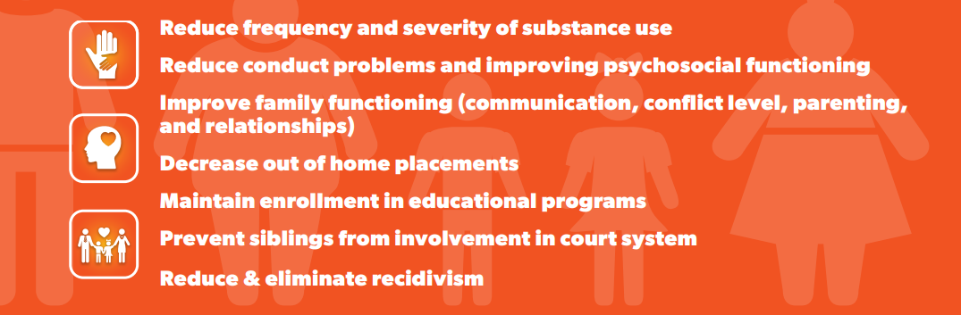

Our Goals

Slide 14
Testimonial
“AMIkids changed our lives. Instead of fighting and arguing, we now know how to communicate our wants and needs”.

Slide 15
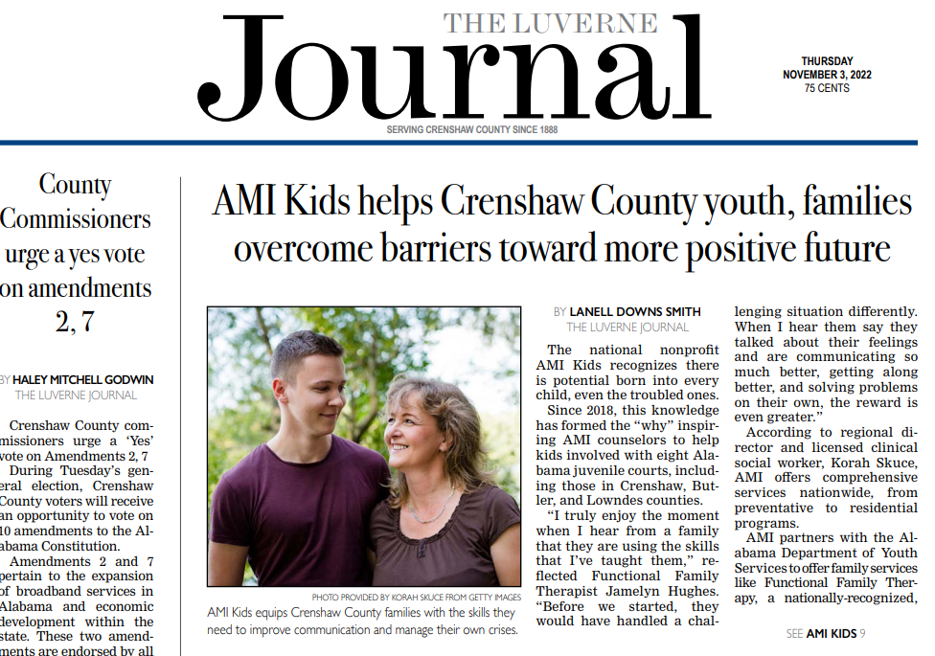
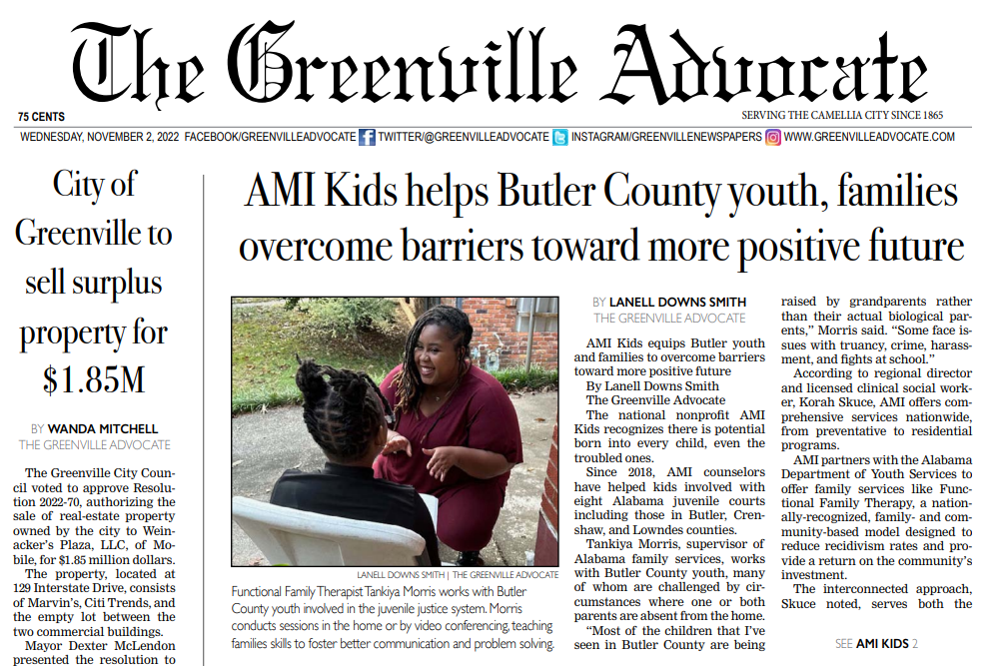
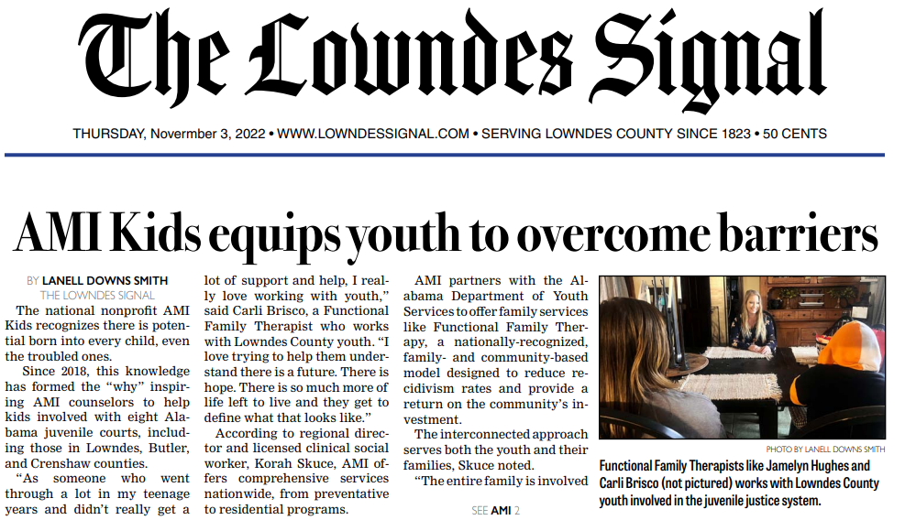
Testimonials

Slide 16
Measured Outcomes
Successful Completion
Living at Home
Violation Free
Enrolled in Educational Program
Increase overall family functioning
Reduce risk factors & increase protective factors
Adherence to FFT Model Fidelity
Notes:
I think choose between this one or the 2 Results driven slides. Can just hide one don’t want

Slide 17
Results Driven and Data Based
Reduction in
Recidivism rates
Crime severity for those that do reoffend
School drop out rates
Out of home placements
Sibling crimes
Drug use and drug related crimes
Interpersonal Distress
Adult Incarcerations

Slide 18
Results Driven and Data Based
Increase In
Treatment Completion Rates
Overall family functioning
GEDs and HS Graduation rates
Cost return (up to $14.87 return for each dollar spent)

Slide 19
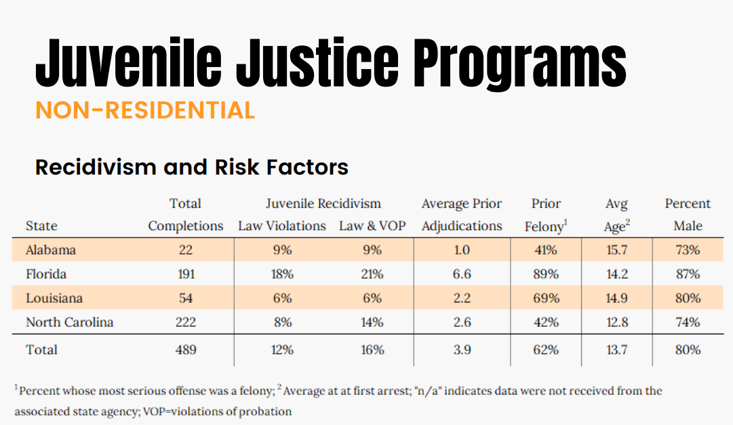
AMIkids Recidivism
2022 Recidivism reduced to only 9%! These were youth served 2021
Notes:
These are youth served in calendar year 2020. Despite Covid, shut downs, and virtual sessions, 1 year recidivism still only 9%.
Our most recent Outcomes report (youth served in 2021) recidivism reduced to only 8%

Slide 20
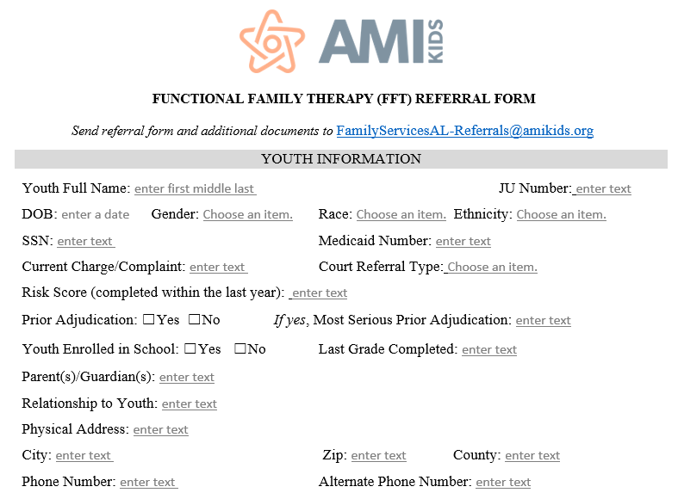

Slide 21
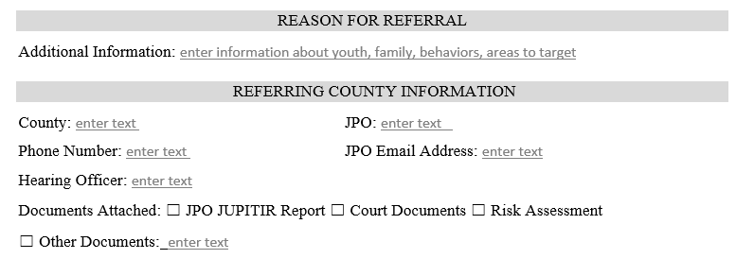

Slide 22
Referrals
More Information can be found at:
www.amikidsAlabamaFamilyServices.org
Send referral packet to:
FamilyServicesAL-Referrals@amikids.org

Slide 23
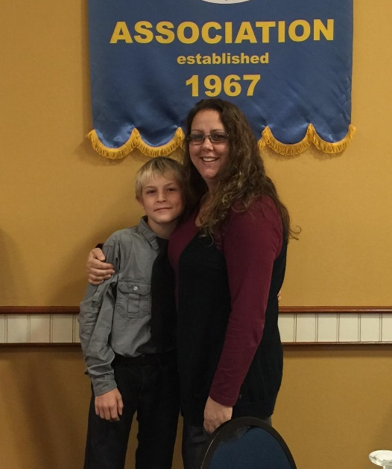
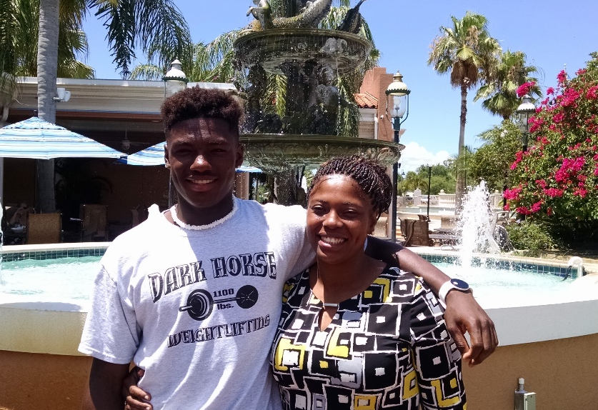
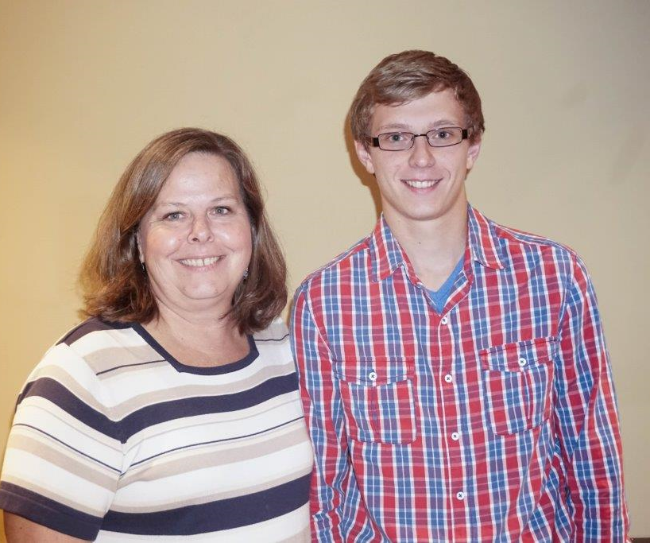
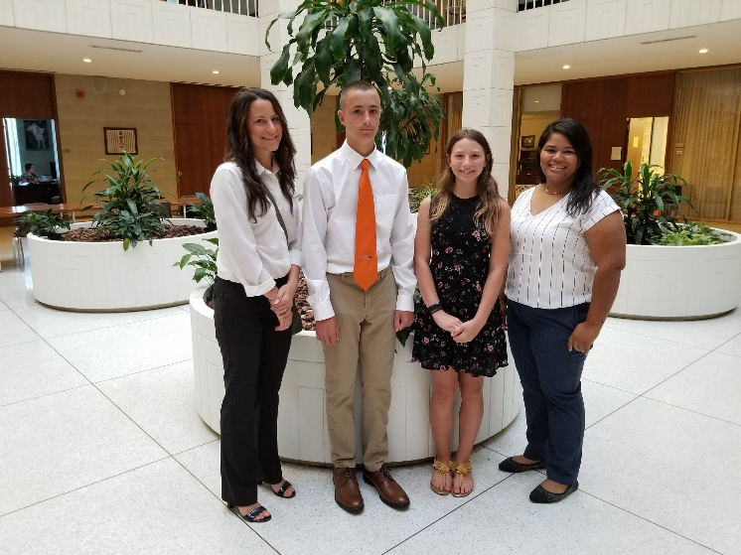
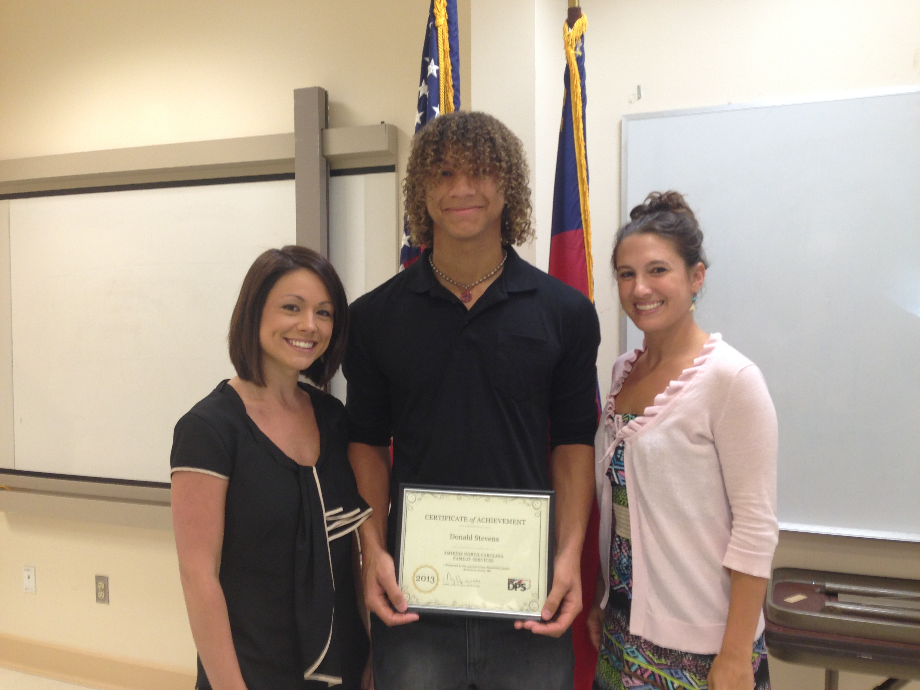

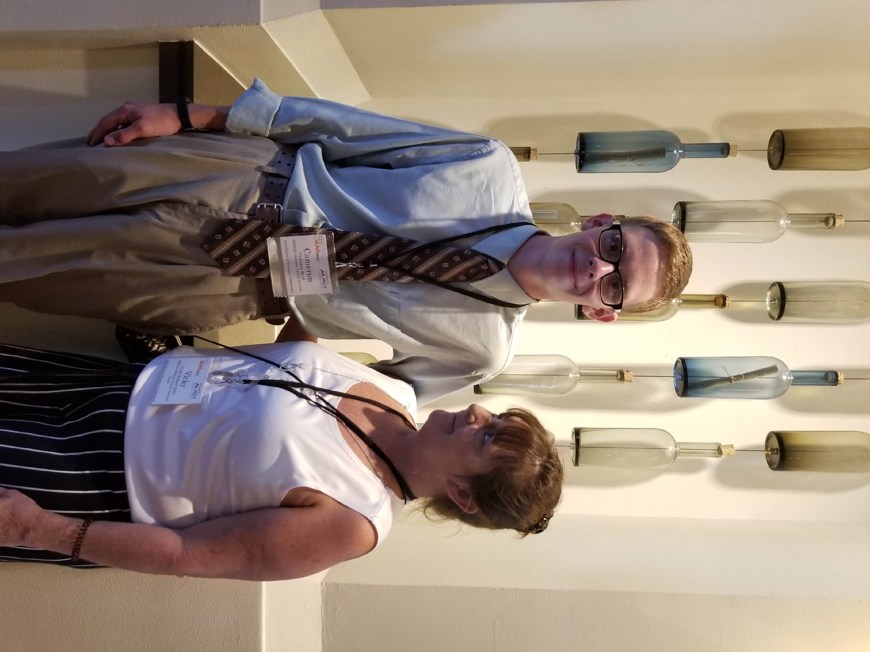
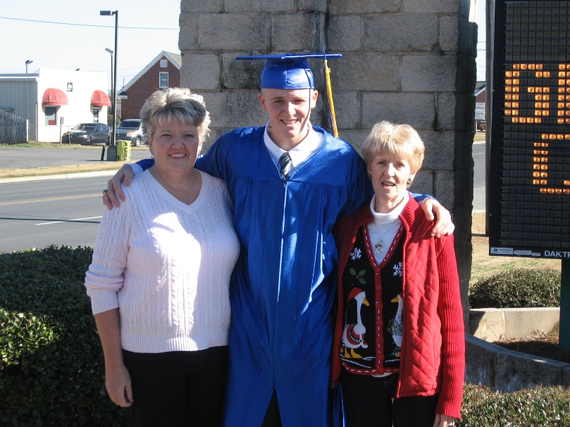

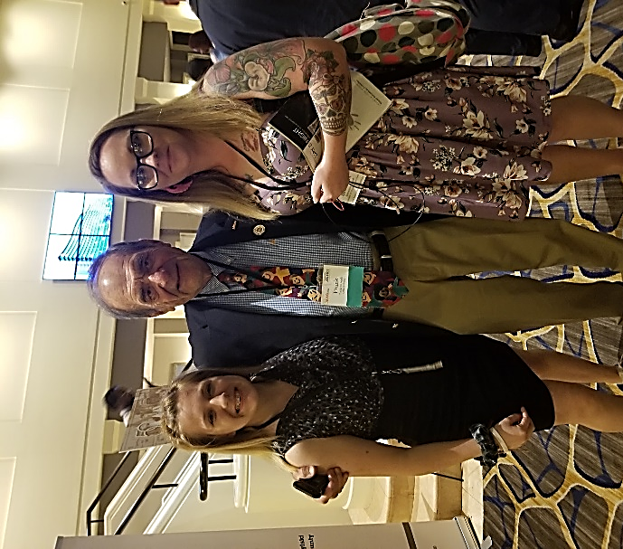
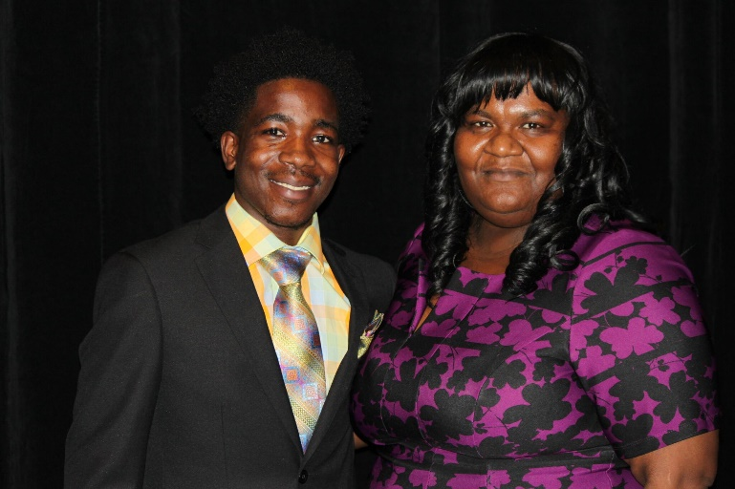
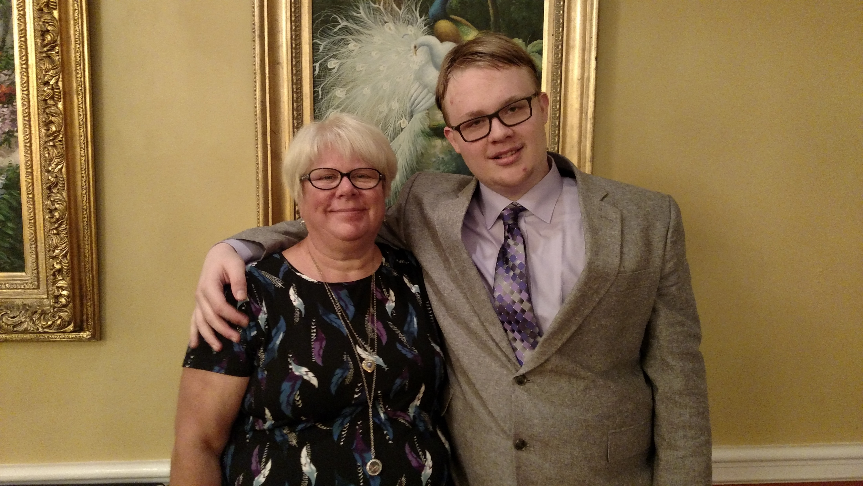
Our Alumni Says,
“Thank You!”

Slide 24

Q & A
Notes:
Appropriate referrals could include the following:
Families with high level of conflict
Youth at risk for out of home placements
Youth with siblings at risk of delinquency or out of home placements
Youth with mental health diagnosis or other behavioral challenges
Eligibility Criteria:
Youth must between ages of 10-18
Must be living with long term family (short term foster care is not appropriate)
Must be able to commit at least 4 months to program
Must have intellectual capacity to benefit from talk therapy (no hard IQ cut off)
Must not be involved in other family based therapy or intensive in home services
Must be Court Involved

Slide 25
Contact
Tankiya Morris
Program Manager/FFT Supervisor & Sr. Site Lead
334-312-2302
TMorris@amikids.org
AMIKids Alabama Family Services
600 Interstate Park Dr.
Suite 601
Montgomery, AL 36109

